Slide 1

MCTS Guide to Microsoft Windows 7
Chapter 10
Performance Tuning

Slide 2
Objectives
Identify several key performance enhancements
Describe performance tuning concepts
Use Performance Monitor
Use Task Manager
Understand performance ranking
Optimize system performance

Slide 3
Performance Enhancements
Performance enhancements in Windows 7
  Windows SuperFetch
  Low-priority I/O
  Windows ReadyBoost
  Windows ReadyDrive
  Automatic defragmentation

Slide 4
Performance Tuning Overview
Performance tuning
  A process rather than an event
Performance tuning process consists of:
  Establishing a baseline
  Recognizing bottlenecks
  Tuning performance

Slide 5
Establishing a Baseline
To recognize system bottlenecks, you must first establish a baseline
Baseline
  Set of performance indicators captured when system performance is acceptable
Performance indicators are often called counters
  Display values for system characteristics
Establishing a baseline
  Verify no unusual activity is happening on the workstation
  Measure performance indicators over time

Slide 6
Recognizing Bottlenecks
Bottlenecks
  Occur when a limitation in a single computer system component slows down the entire system
Disk bottlenecks
  Occur when applications want to read and write information to the physical disk
    Faster than the disk can manage
  To increase disk performance
    Upgrade the drive controller
    Upgrade the disks
    Implement RAID0 or RAID5
    Move the paging file to a nonsystem disk

Slide 7
Recognizing Bottlenecks (cont'd.)
Memory bottlenecks
  Applications require more memory than is physically available
  To reduce the use of virtual memory
    Increase the amount of physical memory
    Run fewer applications at once

Slide 8
Recognizing Bottlenecks (cont'd.)
Processor bottlenecks
  Too much work for a processor
  To resolve processor bottlenecks
    Change to a faster processor
    Add additional processors
    Change to a multicore processor
Network bottlenecks
  More common for servers than computers running Windows 7
  Multiple computers accessing a single server may overwhelm the network connection to the server

Slide 9
Tuning Performance
Steps
  Create a baseline for the computer
  Compare the baseline to current indicators
  Identify possible causes for variations
  Identify possible fixes for variations from the baseline
  Select a fix to implement
  Implement the fix and monitor for changes
  If not resolved, undo the fix and repeat step 5
  If resolved, document solution for future reference

Slide 10
Performance Monitor
Performance Monitor
  MMC snap-in that is used to monitor system performance indicators
Areas
  Resource Monitor
  Performance Monitor
  Reliability Monitor
  Data Collector Sets
  Reports

Slide 11
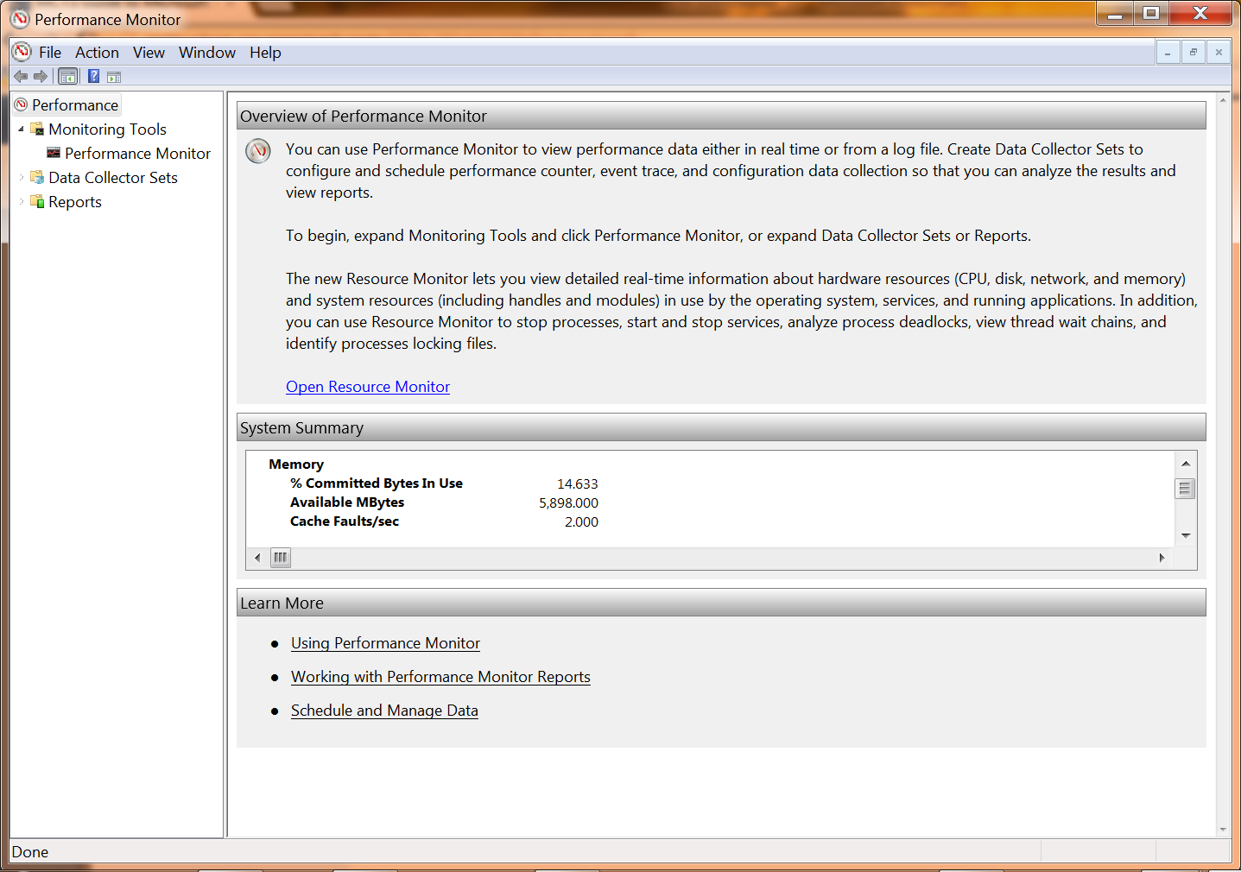
Performance Monitor Window

Slide 12
Resource Monitor
Resource Overview
  Provides real-time monitoring of the most common system performance indicators
CPU
  Indicators
    CPU Usage
    CPU Maximum Frequency
  Characteristics about running processes
    Image, PID, Description, Threads, CPU, Average CPU

Slide 13
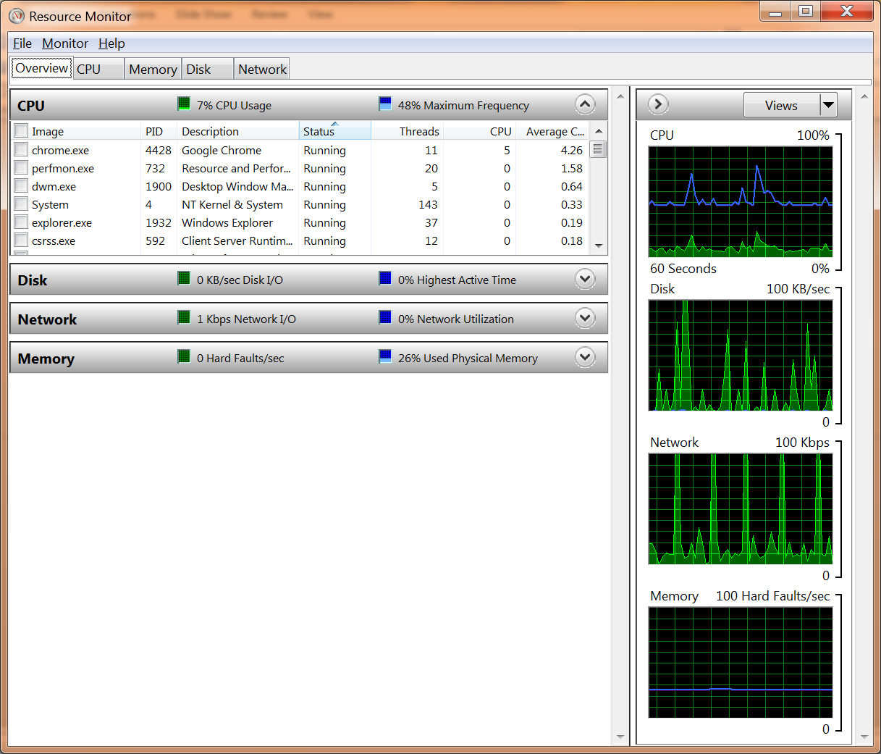
Resource Monitor CPU

Slide 14
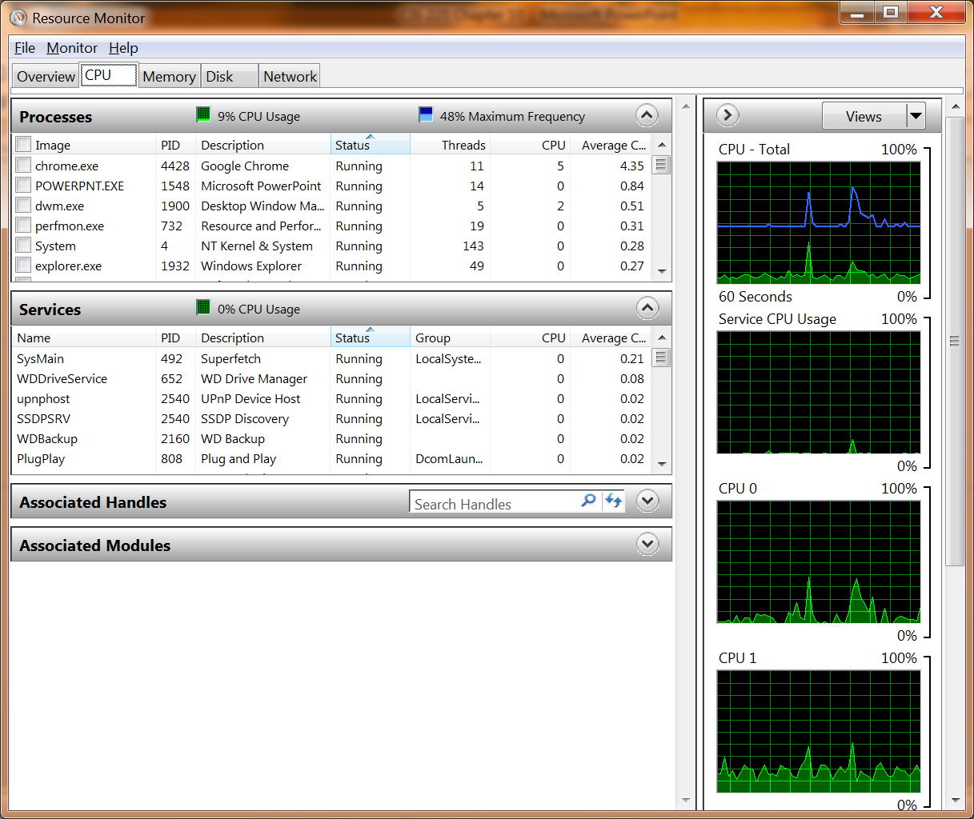
Resource Monitor CPU

Slide 15
Resource Monitor (cont'd.)
Disk
  Performance indicators
    Current disk input/output in KB/sec
    Highest Active Time
  Characteristics about processes performing disk activity
    Image, PID, File, Read, Write, IO Priority, Response time
Network
  Performance indicators
    Total current network traffic
    Network Utilization

Slide 16
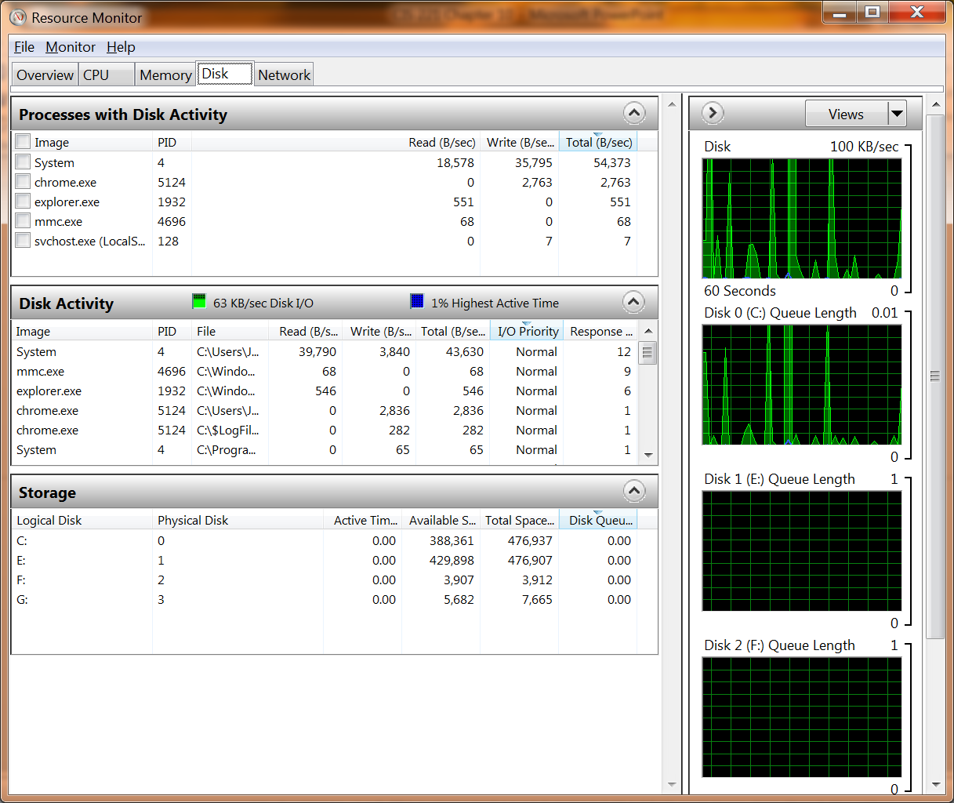
Resource Monitor Disk

Slide 17
Resource Monitor (cont'd.)
Network (cont'd.)
  Characteristics about processes performing network activity
    Image, PID, Address, Send, Receive, Total
Memory
  Performance indicators
    Hard Faults
    Used Physical Memory
  Characteristics about process memory usage
    Image, PID, Hard Faults, Commit, Working set, Shareable, Private

Slide 18
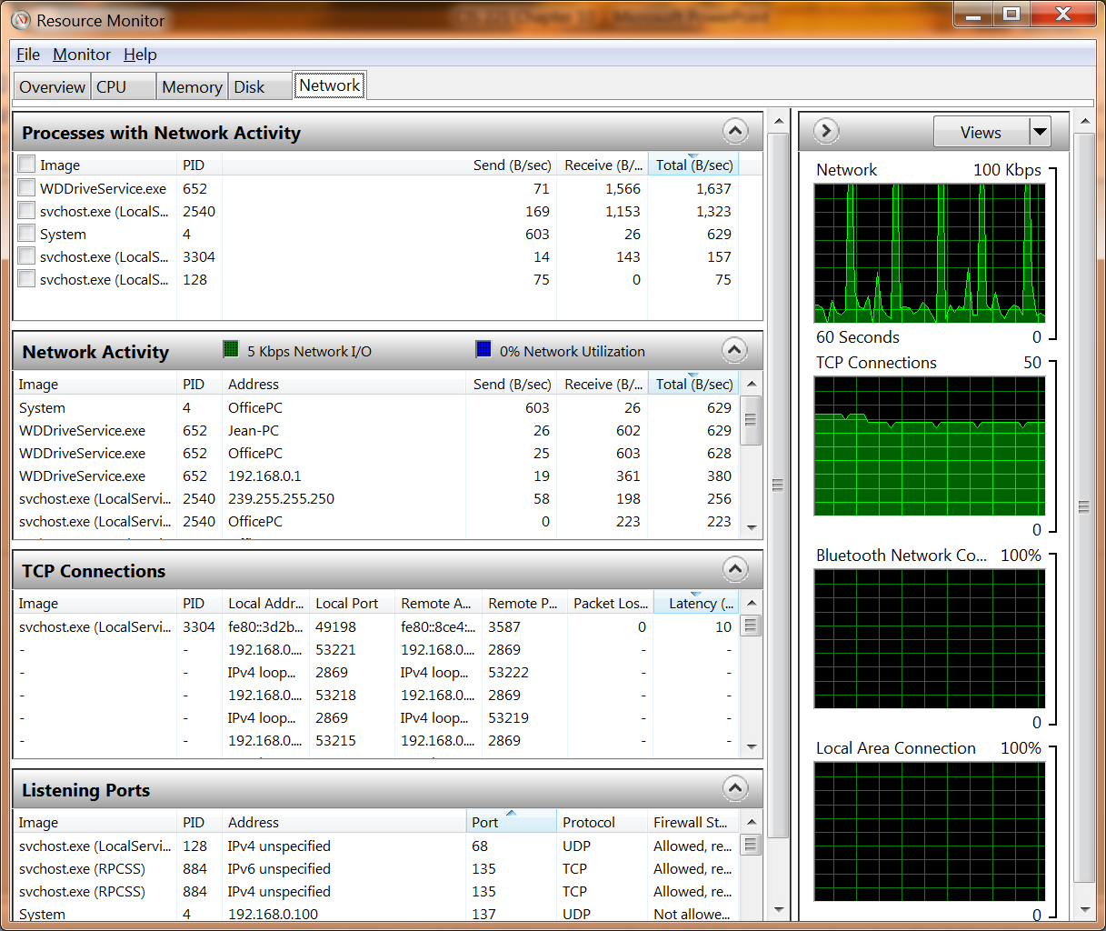
Resource Monitor Network

Slide 19
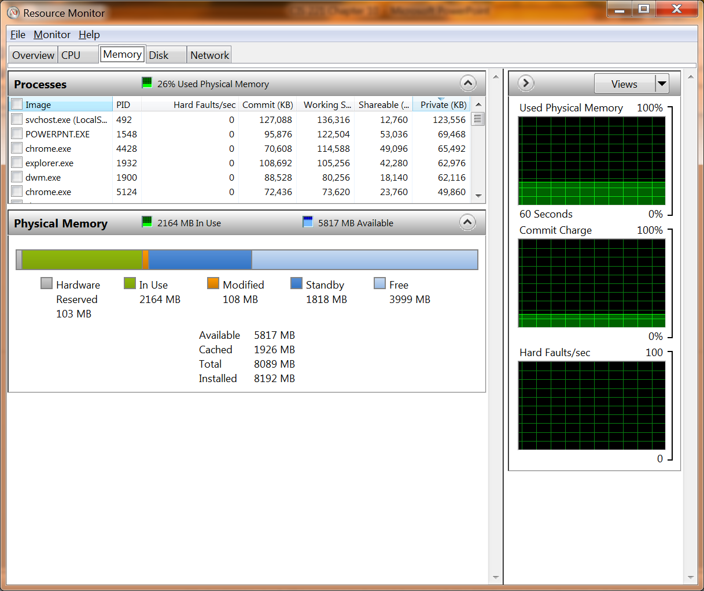
Resource Monitor Memory

Slide 20
Performance Monitor
Performance Monitor
  Tool within Performance Monitor
  Visually displays the data generated by counters
  View last, average, minimum, and maximum values
  Can view logged data
Counters
  Can select counters to view

Slide 21
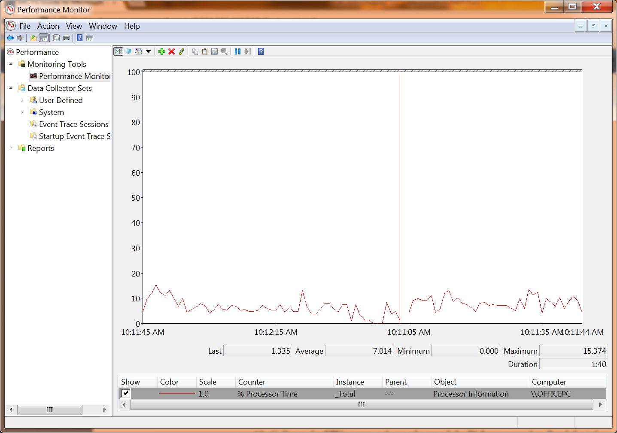
Performance Monitor Graph

Slide 22
Performance Monitor (cont'd.)
Counters (cont'd.)
  Categories
    Cache
    IPv4
    LogicalDisk
    Memory
    Network Interface
    PhysicalDisk
    Processor
    System

Slide 23
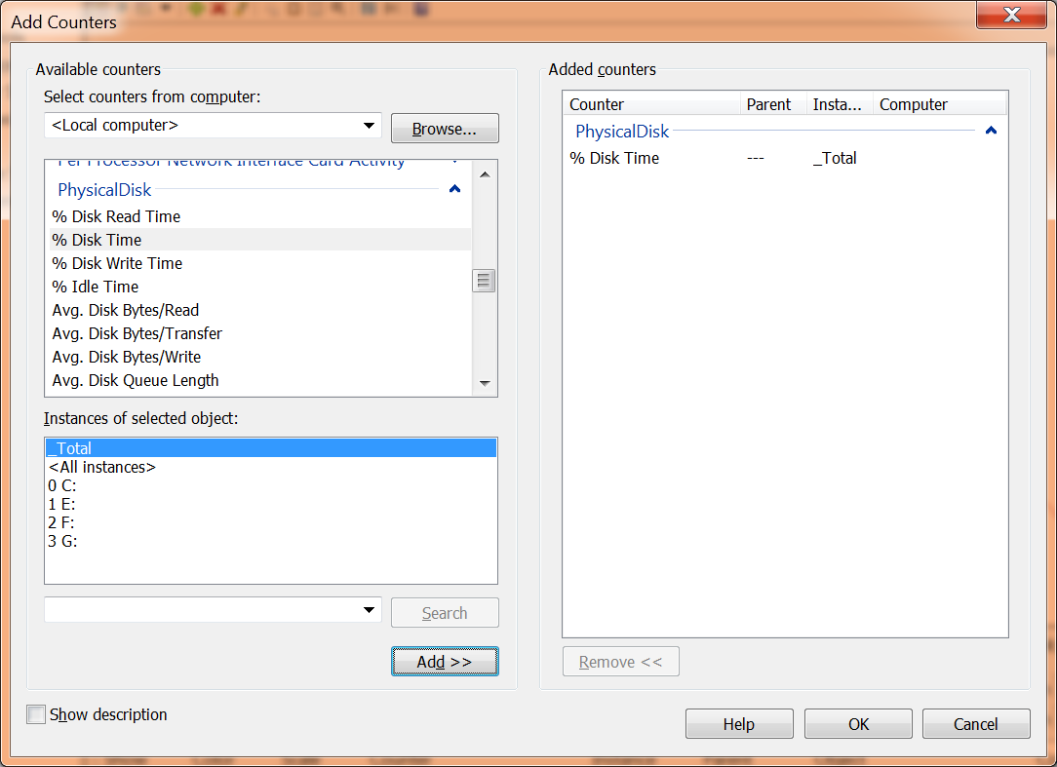
Performance Monitor Counters

Slide 24
Performance Monitor (cont'd.)
Chart types
  Line
  Histogram bar
  Report

Slide 25
Data Collector Sets
Data Collector Sets
  Organize multiple counters into a single unit
    Makes monitoring performance easier to manage
Type of data
  Performance counters
  Event trace
  Configuration
Logging
  Data Collector Set can log performance information to disk

Slide 26
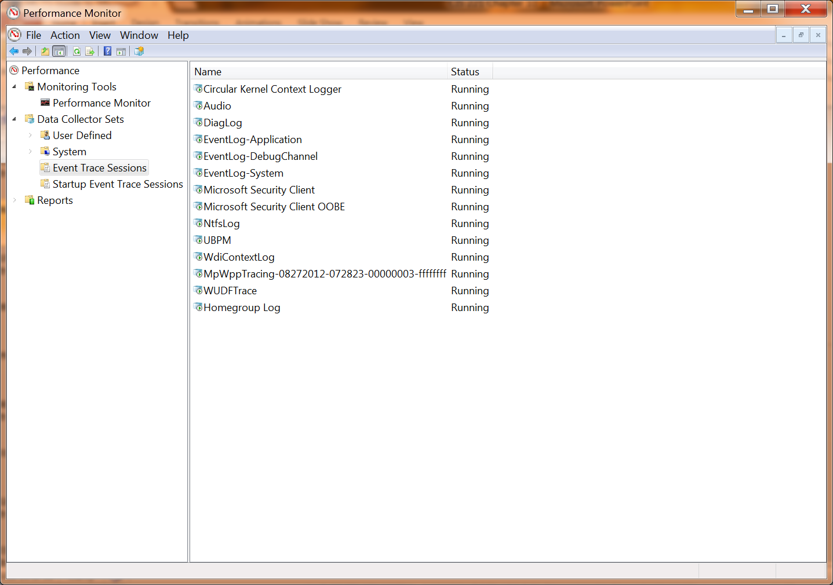
Data Collector Sets List

Slide 27
Data Collector Sets (cont'd.)
Logging (cont'd.)
  For each Data Collector Set, you can specify:
    Root directory
    Subdirectory
    Subdirectory name format
Starting and Stopping
  Data Collector Sets are not always running
  You can manually start Data Collector Sets
  If you are collecting a baseline
    Schedule the Data Collector Set to run at a regular time

Slide 28
Data Collector Sets (cont'd.)
Alerts
  For performance counters, you can configure alerts instead of logging to disk
  When an alert triggers, the following can be performed:
    Log an entry in the application event log
    Start a Data Collector Set
    Run a scheduled task
Data Manager
  User can automatically control log files and reports that can be generated by Data Collector Sets

Slide 29
Data Collector Sets (cont'd.)
Data Manager (cont'd.)
  You can specify the following (cont'd.)
    Minimum free disk space
    Maximum folders
    Resource policy
    Maximum root path size
    Enable data management and report generation

Slide 30
Reports
Reports
  Process and display log file data
You specify rules to process log files
Rule is an XML file that contains instructions specifying how the data is to be processed
Create your own rules for processing log files

Slide 31
Task Manager
Task Manager
  Provides an overview of the current state of a computer
You can access Task Manager several ways
  Press Ctrl+Alt+Del
  Press Ctrl+Shift+Esc
  Right-click the taskbar and click Task Manager
  Run taskmgr.exe from a command prompt

Slide 32
Applications
Applications tab in Task Manager
  Shows all user applications running on the computer
Status is: Running or Not Responding
View process that corresponds with an application
  Right-click the task and click Go To Process

Slide 33
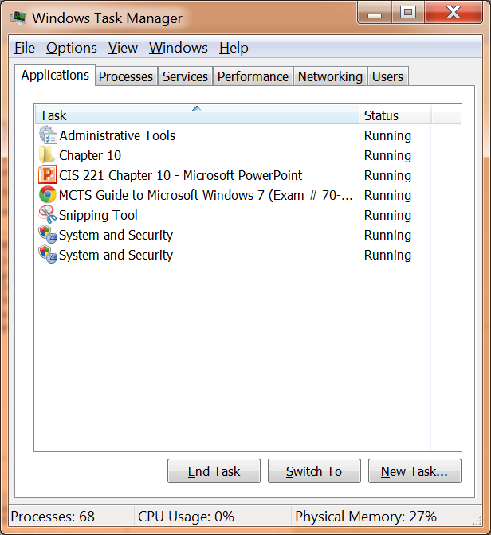
Task Manager Applications

Slide 34
Processes
Processes tab
  Shows processes running on this computer
By default, only processes started by the current user are displayed
Options
  Can optimize the view of processes
    By adding additional columns and sorting based on column information
  Can set the priority of a process
  Can end a specific process or process tree

Slide 35
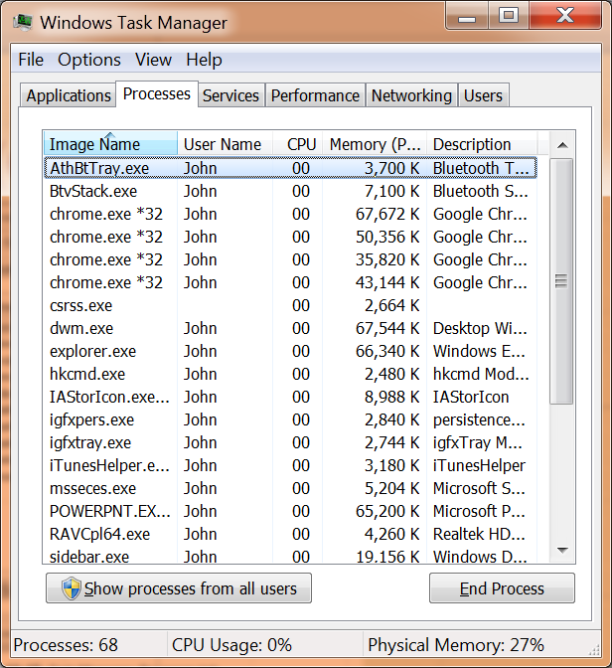
Task Manager Processes

Slide 36
Services
Services tab
  List of the services running on Windows 7
You can locate a process associated with a particular service and can start and stop services

Slide 37
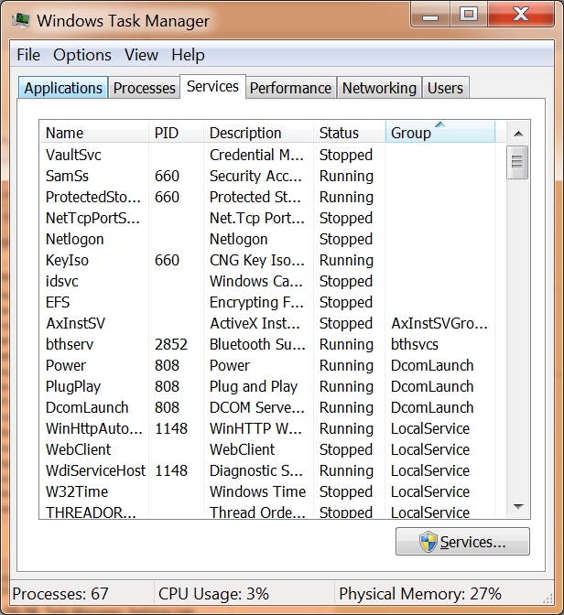
Task Manager Services

Slide 38
Performance
Performance tab
  Quick overview of system performance for memory and processor utilization
Current CPU usage is shown as a bar chart
  Recent CPU usage history is shown as a line graph

Slide 39
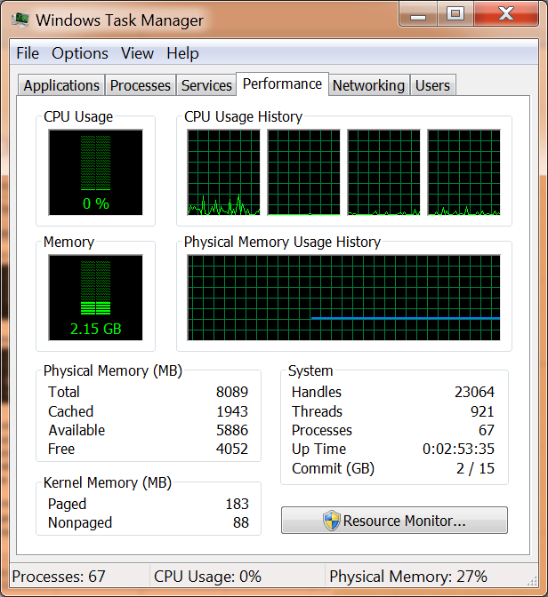
Task Manager Performance

Slide 40
Other Tabs
Networking tab
  Line graph of recent network utilization for each network connection
Users tab
  List of users currently logged on

Slide 41
Performance Ranking
Windows Experience Index
  Provides an objective measure of system performance
Windows 7 ranks five elements
  Processor
  Memory (RAM)
  Graphics
  Gaming graphics
  Primary hard disk

Slide 42
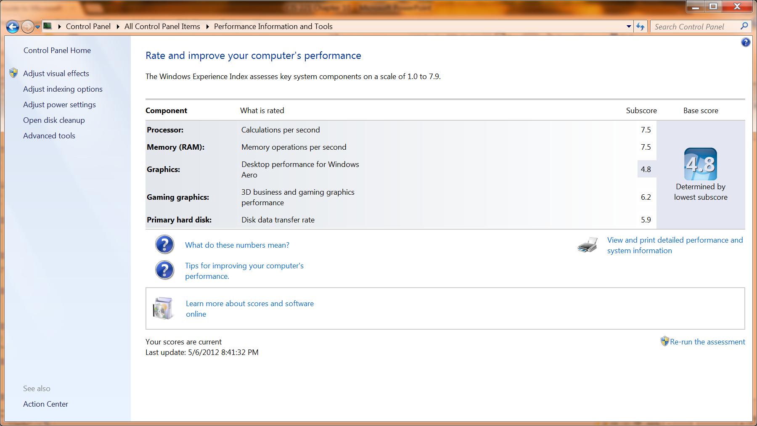
Performance Ranking (cont'd.)

Slide 43
Performance Ranking (cont'd.)
Individual subscores used to create a Base score
Base score
  Overall ranking of your system
  Ranking is from 1 to 5 (5 the best)
  Not simply an average of the subscores
General performance guidelines for base scores
  Base score of 1 or 2
    Can access Internet and run business applications

Slide 44
Performance Ranking (cont'd.)
General performance guidelines for base scores
  Base score of 3
    Can use most new Windows 7 features
  Base score of 4 or 5
    Can use all new Windows 7 features

Slide 45
Performance Options
Performance Options dialog box
  Optimize visual effects, processor scheduling, and virtual memory
Access Performance Options dialog box
  Click Adjust visual effects task in the Check the Windows Experience Index Control Panel applet

Slide 46
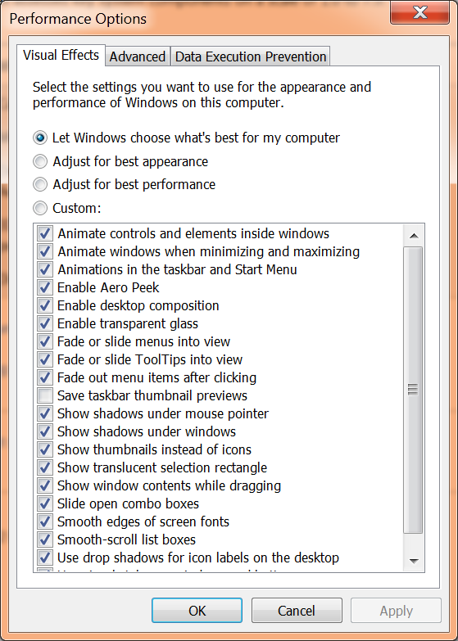
Performance Options Visual Effects Tab

Slide 47
Virtual Memory
By default, paging file is managed automatically by Windows
Minimum size is 16 MB and the maximum size is configured as 300% of RAM
Can manually configure the paging file
Most Windows 7 computers have one hard disk
  And increasing performance is not possible by adjusting the virtual memory settings
Can specify that no paging file is to be used

Slide 48
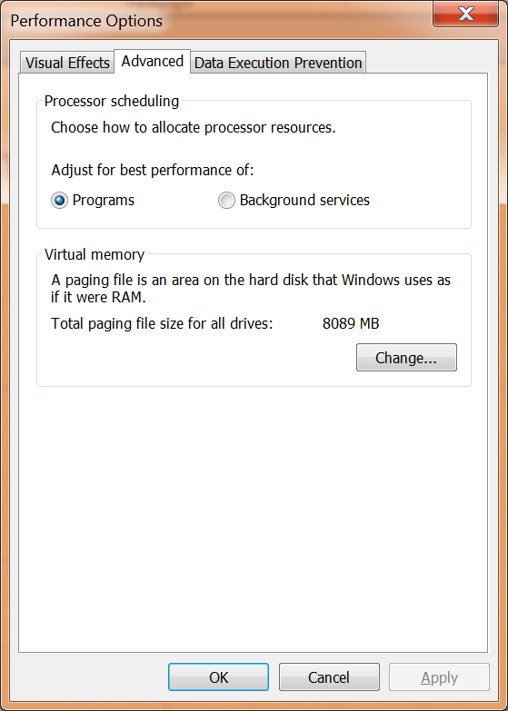
Virtual Memory Dialog Box

Slide 49
Data Execution Prevention
Data Execution Prevention (DEP)
  Processor feature that Windows 7 can use
  Monitors processes to ensure that they do not access unauthorized memory spaces
If processor does not support DEP
  Some software-based DEP features that can be performed by Windows 7
By default, DEP is enabled for only essential Windows programs and services

Slide 50
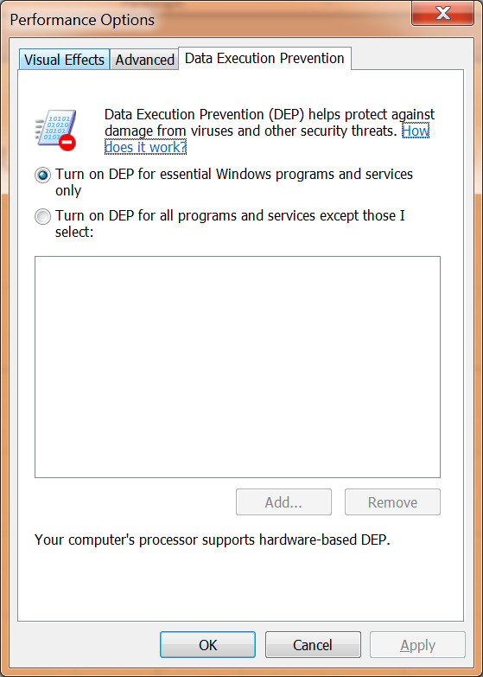
Data Execution Prevention Tab

Slide 51
Summary
Windows 7 is a higher performing operating system than previous versions of Windows
Establishing a baseline for performance tuning allows you to recognize variations from normal system behavior and identify system bottlenecks
Performance Monitor can monitor system performance, monitor system reliability, create alerts, log performance activity, and generate reports
Data Collector Sets control logging of performance data and create alerts

Slide 52
Summary (cont'd.)
Task Manager allows you to quickly view system process information
Performance rankings generated in Performance Information and Tools ensure that you understand the capabilities of your computer
Performance Options allow you to configure visual effects, processor performance, virtual memory, and Data Execution Prevention

